Slide 1

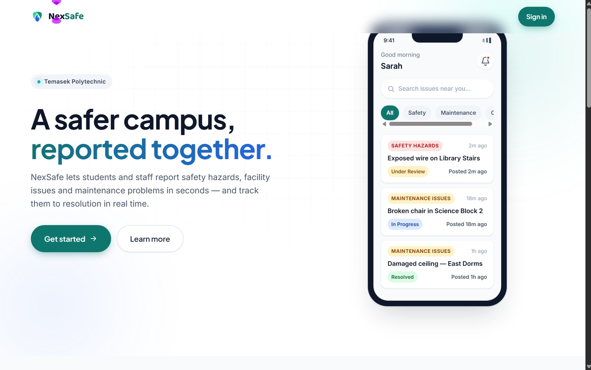
NexSafe
Smart Issue Reporting Platform
A serverless AWS web application that lets students report campus hazards with AI-verified photo evidence, and lets staff review and resolve them.
Live URL https://d2a0yi8f3vpirh.cloudfront.net/
Khin Pyaesone Win · 2503083D · PC02 · Tutor: Jin Lee ·
S3 · CloudFront · Cognito · API Gateway · Lambda · RDS MySQL · Rekognition Custom Labels · SNS · Location · IAM
Notes:
Good morning. I'm Khin Pyaesone Win, and this is NexSafe, a smart issue reporting platform for campus safety, built and deployed entirely on AWS.
The site is live at the CloudFront URL on screen. In the next ten minutes I'll cover the website itself, every AWS service and what it does, how I developed the Rekognition Custom Labels model, the full deployment process, the security model, and the problems I had to solve along the way.
[0:00-0:20]

Slide 2
Presentation Contents
Six sections, ending with a live demonstration of the deployed website
1
2
3
Website Overview
Services Used
Rekognition Development
The problem, the users, and both role journeys
What every AWS service does inside NexSafe
Custom Labels dataset, metrics and integration
4
5
6
Deployment Process
Security & Database
Challenges & Next Steps
Eleven steps from S3 storage to CloudFront delivery
Least privilege, JWT roles and full CRUD
What broke, how I fixed it, what comes next
2
Notes:
Here is the running order. I'll begin with what the website actually does, then move into the cloud engineering behind it: the services, the AI model, the deployment sequence, and security. I'll finish with the challenges and future improvements, and then run the live demonstration.
[0:20-0:40]

Slide 3
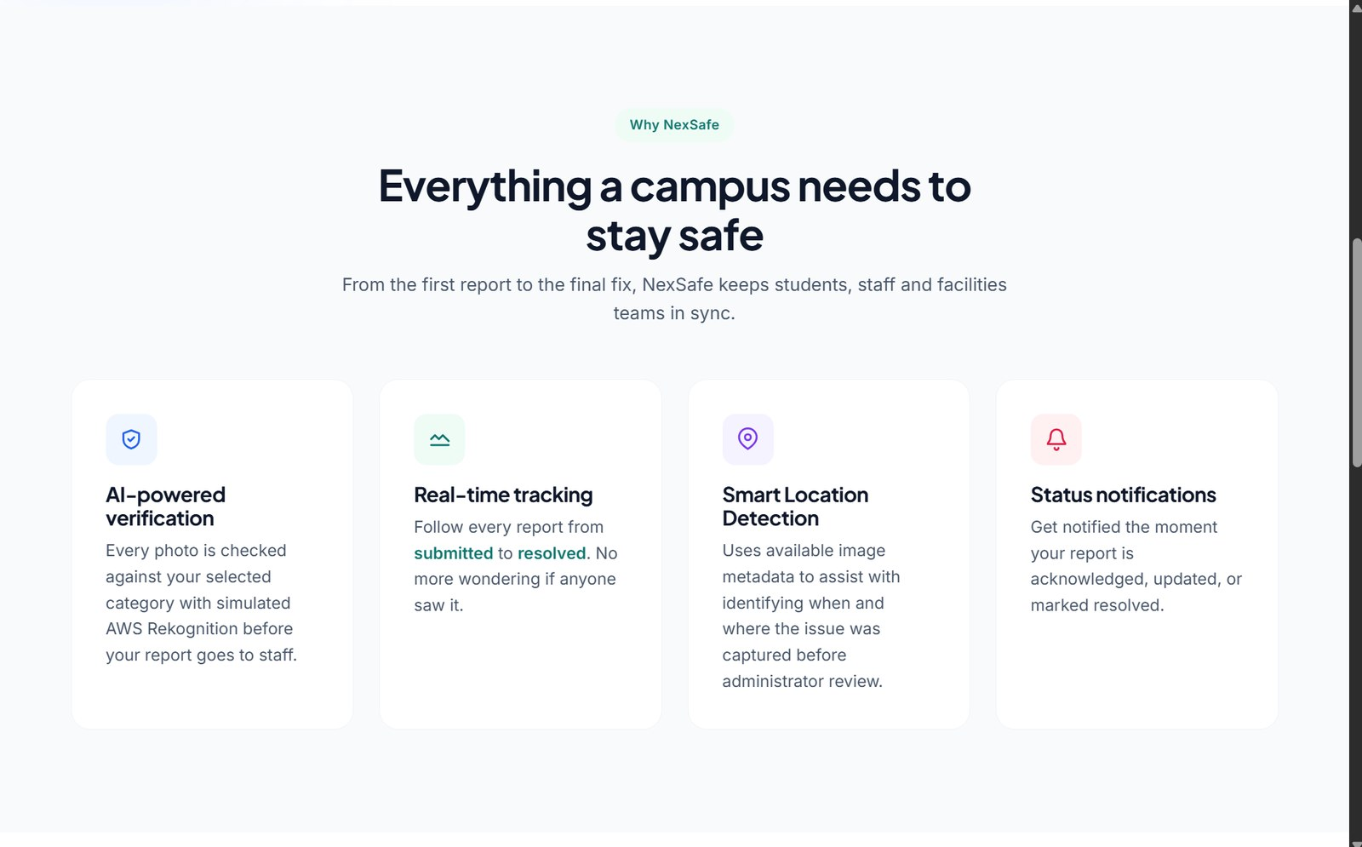
Overview of the Website
One structured path from a hazard being noticed to a hazard being resolved
The problem
Broken furniture, exposed wiring and water leaks get reported late, verbally, or not at all. Students often do not know who to contact, and verbal reports are delayed before reaching maintenance.
The NexSafe solution
Students submit a photo, issue type, description and a map-pinned location. Rekognition verifies the photo before submission. Staff review, prioritise, update and resolve — and the student sees every status change.
Landing page — what NexSafe offers students and staff
9
10
5
7
Two roles, one platform. Students report and track. Staff review, set priority, publish updates and delete invalid reports.
web pages
AWS services
AI issue classes
API routes
3
Notes:
The problem is a reporting-friction problem. A student notices a hazard, doesn't know the correct channel, and the issue never reaches maintenance — or reaches it days later through a lecturer.
NexSafe removes that friction. One sign-in, one form, photo evidence, a map pin, and an AI check before the report is even submitted. Staff get a queue instead of scattered messages, and the student can see the status change without chasing anyone.
The scope is nine pages, ten AWS services, five trained AI classes and seven API routes.
[0:40-1:20]

Slide 4
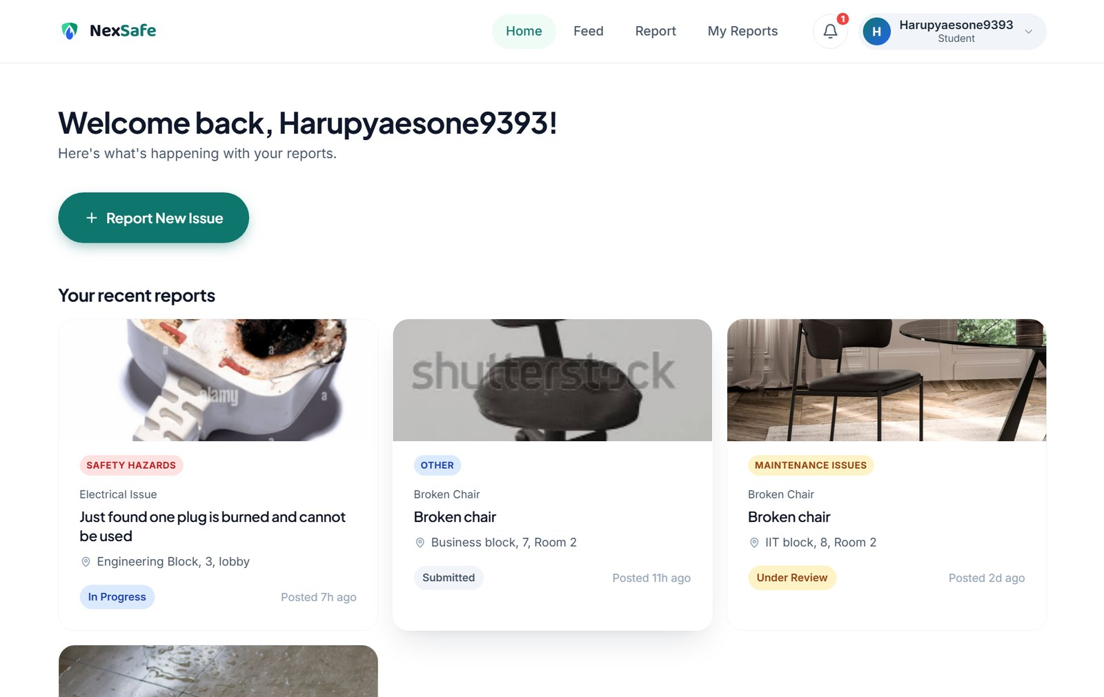
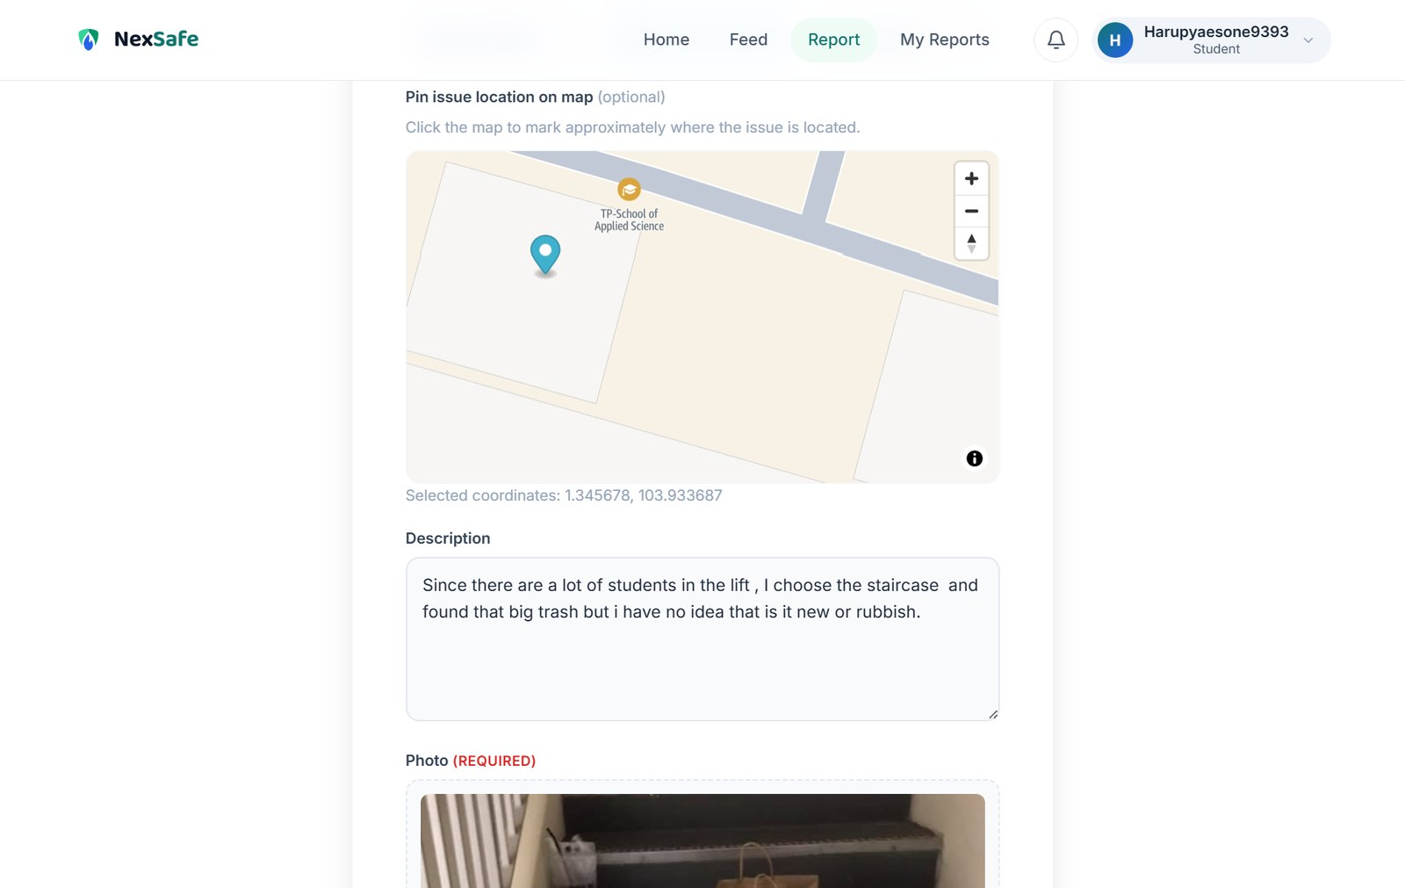
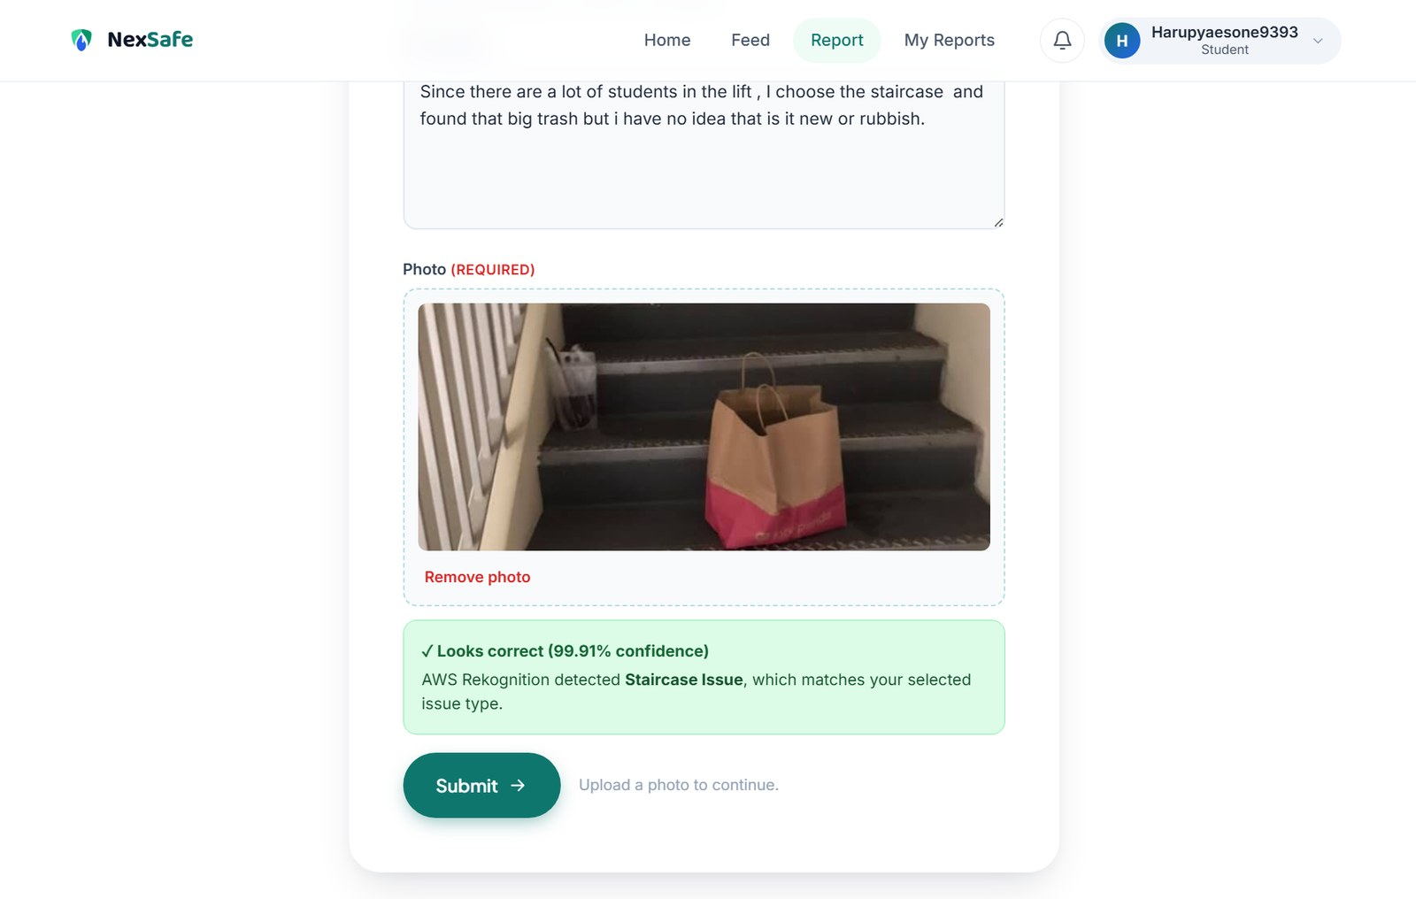
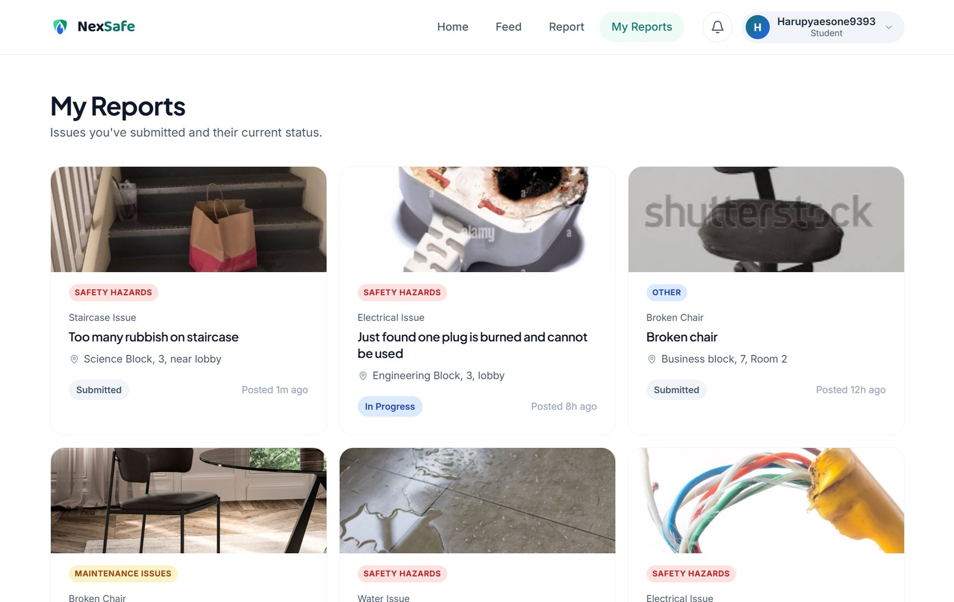
Student Journey
Sign in, report with evidence, get an AI check, then track the outcome
1
Sign in & dashboard
2
Report & pin location
3
AI verification
4
Track in My Reports
Cognito authenticates the student and the dashboard shows their own recent reports.
Structured fields plus an Amazon Location map that stores the exact latitude and longitude.
Rekognition returns the label and confidence, and warns if it disagrees with the student's choice.
Submitted, Under Review, In Progress, Resolved or Rejected — visible to the student.
Every submission carries identity, evidence, coordinates and an AI verdict before it ever reaches the staff queue.
4
Notes:
This is the student path, and it is what I will demonstrate live.
The student signs in with a Cognito account that belongs to the students group. On the report page they fill in the issue type, building, level and description, then click the Amazon Location map to drop a pin — those coordinates are stored to six decimal places.
When they attach a photo, the browser sends it to my analyze-image endpoint and Rekognition Custom Labels replies with a label and a confidence score. In this screenshot it matched Staircase Issue at 99.91 percent. If the model disagrees with what the student selected, the interface warns them before submission.
After submitting, My Reports shows the live status as staff work on it.
[1:20-2:10]

Slide 5
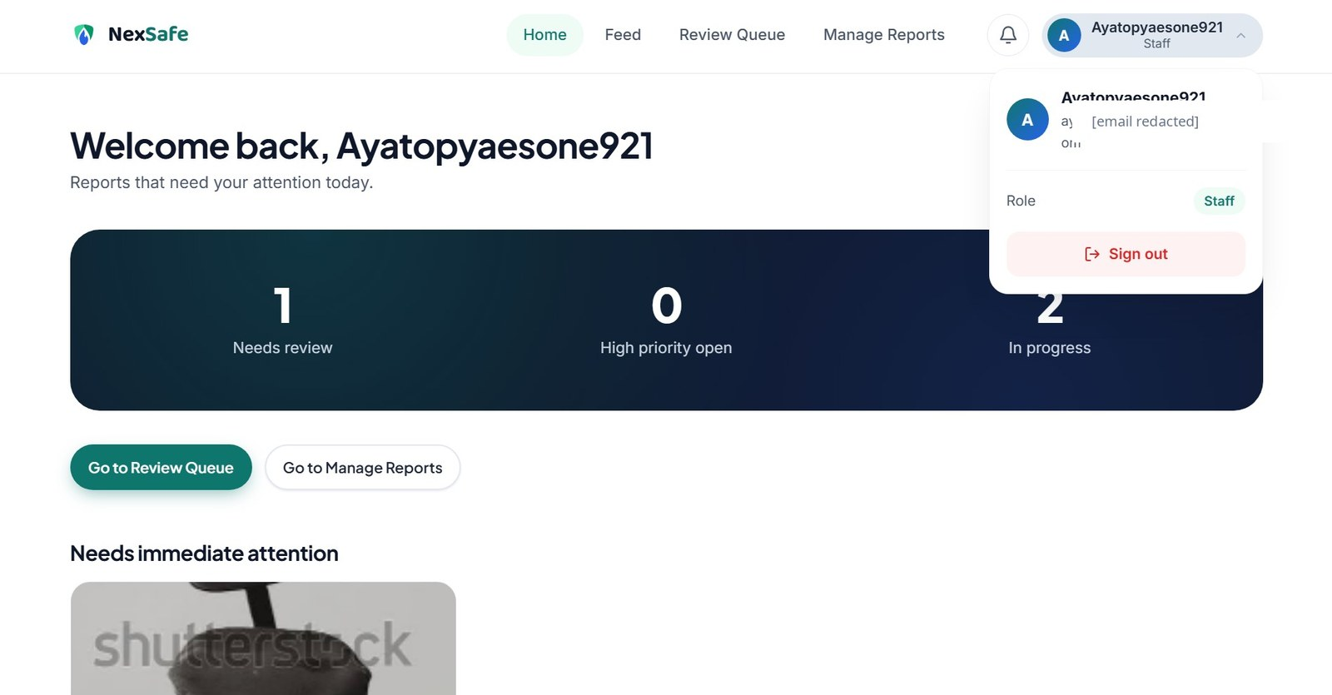
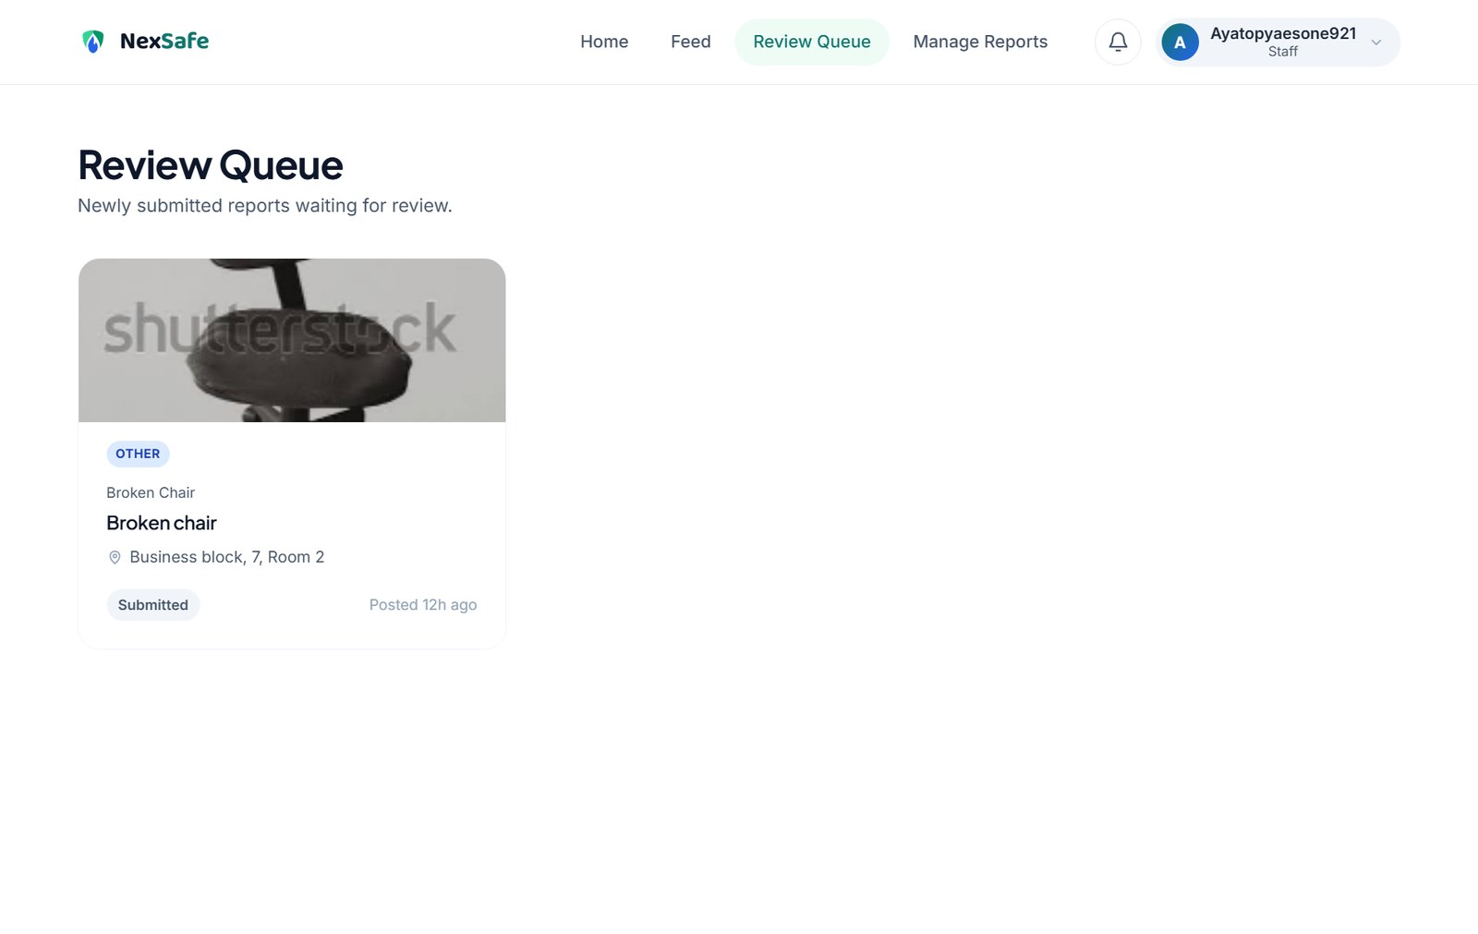
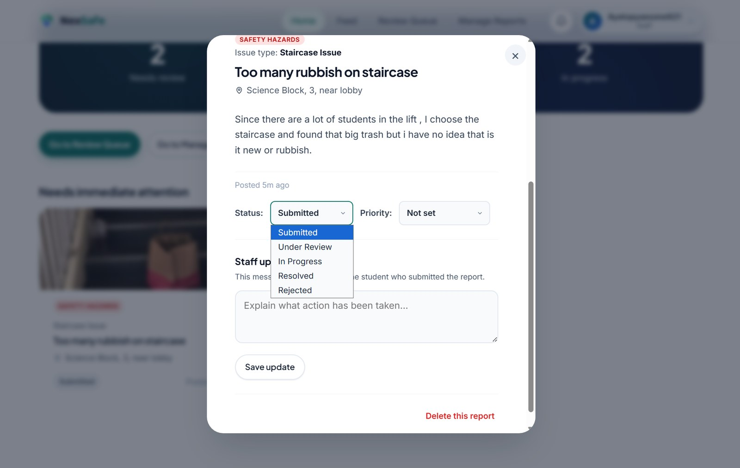
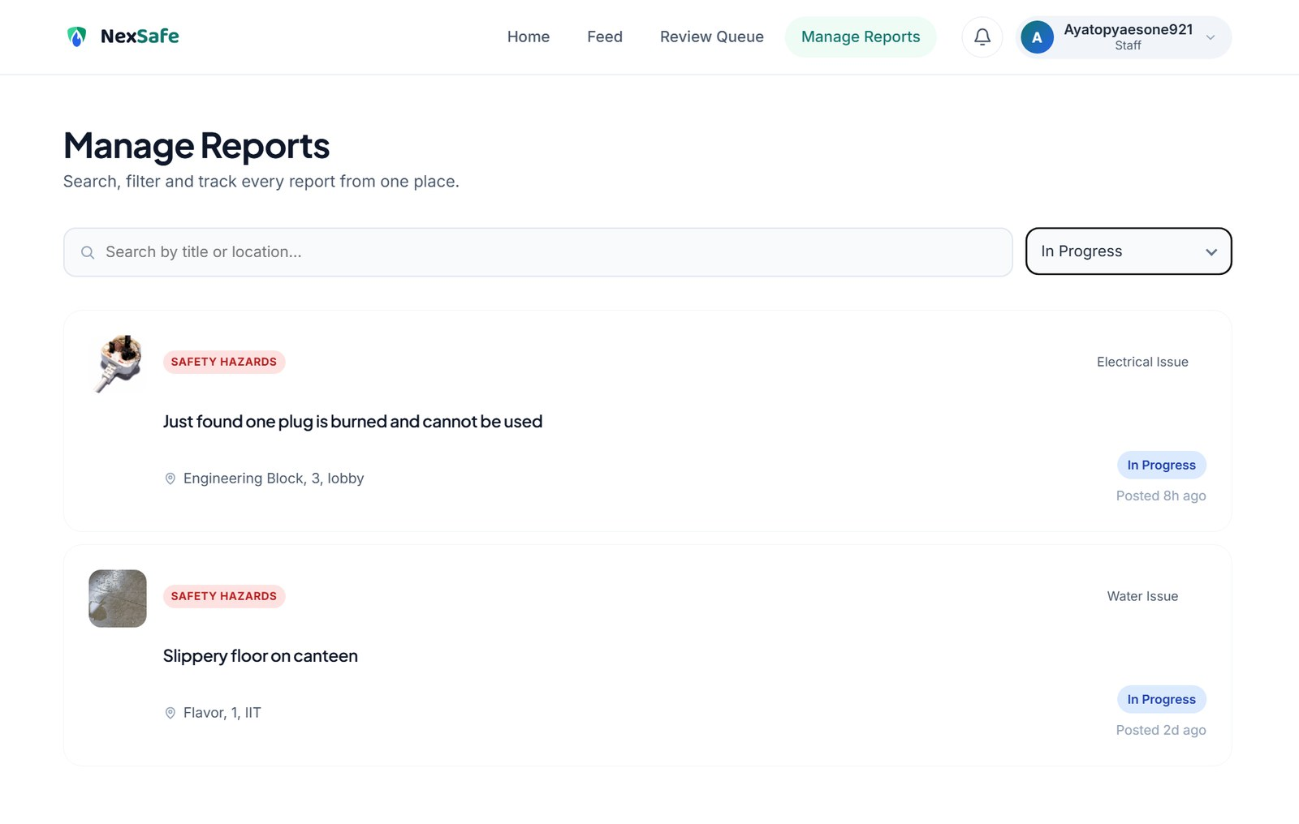
Staff Journey
A separate role interface driven by the Cognito group claim, not by hidden buttons
1
Staff dashboard
2
Review Queue
3
Update & resolve
4
Manage Reports
cognito:groups = staff unlocks a different navigation and operational counters.
Newly submitted reports arrive with photo evidence and location attached.
Set status and priority, write a staff update, or delete an invalid report.
Search and filter every report by status to track outstanding work.
Update and delete are staff-only in the backend Lambda as well — removing the button would not grant a student the permission.
5
Notes:
The staff side is the same deployment, but Cognito group claims change what the user gets.
A staff account lands on an operational dashboard, works through the Review Queue, and opens a report to set status and priority and write a staff update that the student will see. Manage Reports gives a filtered view across everything.
The important engineering point is on the band at the bottom: the role separation is enforced in the Lambda, not in the interface. If someone called the update or delete route directly without the staff group in their token, the backend rejects it.
[2:10-2:45]

Slide 6
Breakdown of Services Used
Ten AWS services — five required by the project, five added for security, interactivity and reach
Core project services
Additional services — added value
Amazon S3
Amazon Cognito
Hosts the static website, the Rekognition datasets and every uploaded report photo.
Identity plus students / staff group claims that drive role separation.
AWS Lambda
Amazon CloudFront
Two functions: reports CRUD with SNS (Node.js) and image analysis (Python).
HTTPS delivery and the only permitted read path into the private S3 buckets.
Amazon API Gateway
Amazon SNS
HTTP API that validates the Cognito JWT and routes each request to Lambda.
Publishes new-report alerts to staff and status updates back to students.
Amazon RDS MySQL
Amazon Location Service
Persistent reports table, indexed on author, status and creation time.
Interactive campus map that records the exact coordinates of an issue.
Rekognition Custom Labels
AWS IAM
Classifies the five campus issue types from the uploaded photo.
Least-privilege permissions for every service-to-service call.
7
Notes:
Here is every service and exactly what it does in this application.
On the left are the five the project requires. S3 is doing three different jobs — website hosting, dataset storage and evidence storage. Lambda is split into two functions so the AI path and the database path can be deployed and debugged independently.
On the right are the five I added, and each one earns its place. Cognito gives me real identity and role separation instead of a fake login. CloudFront gives HTTPS and lets me keep both buckets completely private. SNS closes the communication loop so a student learns their report moved. Amazon Location turns a vague description into precise coordinates. IAM ties the permissions down.
[3:30-4:15]

Slide 7
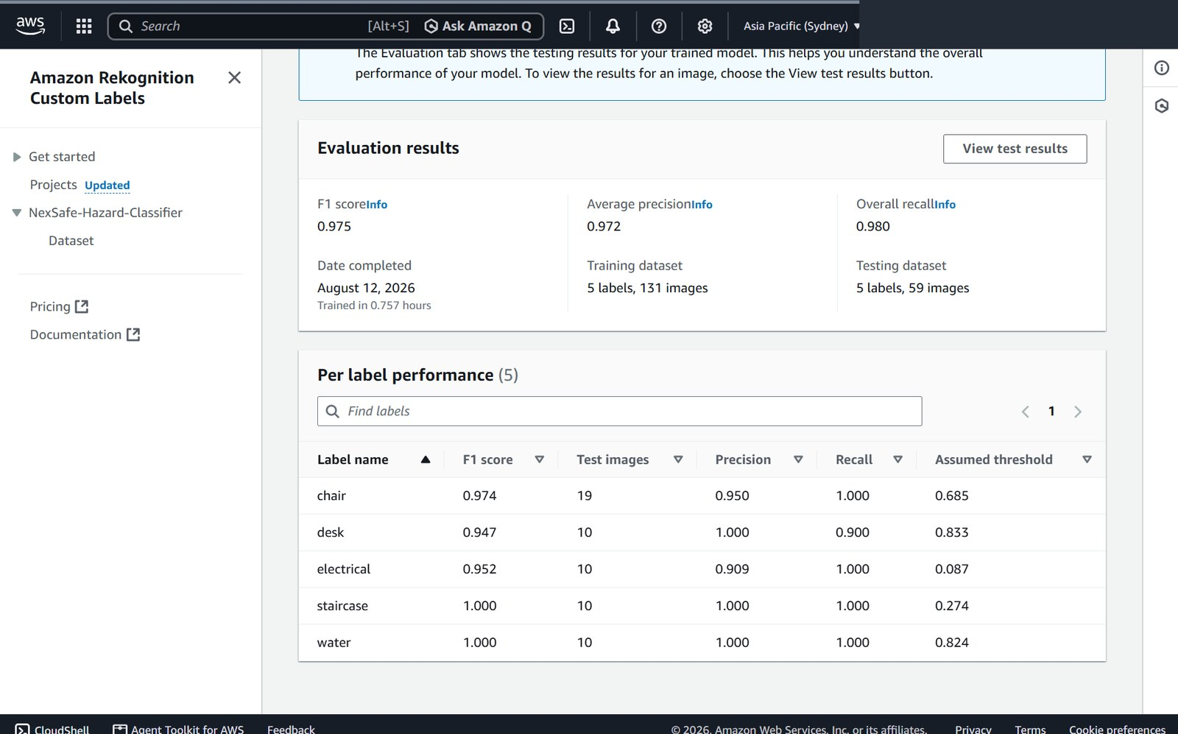
AWS Rekognition Development
A Custom Labels model trained for campus issues — not generic object detection
131
59
0.975
training images
test images
overall F1 score
Purpose-built classes
chair, desk, electrical, staircase and water map one-to-one onto the issue types a student can select.
Dataset organised in S3
dataset/train/<class>/ and dataset/test/<class>/ made class membership explicit before training began.
Per-label F1, precision, recall and assumed threshold
Metrics read before deploy
Project NexSafe-Hazard-Classifier · Region ap-southeast-2 · Runtime 1 inference unit
Precision 0.972, recall 0.980. Staircase and water scored 1.000; desk was weakest at 0.947 and is the next dataset priority.
8
Notes:
Generic Rekognition label detection was not good enough here. It would return 'chair' or 'furniture' without telling me whether that chair is a reportable issue. So I trained a Custom Labels project called NexSafe-Hazard-Classifier with five classes chosen to match the issue options in the form.
I organised the data in S3 by class under dataset/train and dataset/test — 131 training and 59 testing images — so the intended labels were unambiguous before training.
The model reached an overall F1 of 0.975, precision 0.972 and recall 0.980. I used the per-label table on the right as a decision checkpoint, not just proof of success: staircase and water are perfect, desk is the weakest at 0.947, and that tells me exactly where to add images next.
[4:15-5:00]

Slide 8
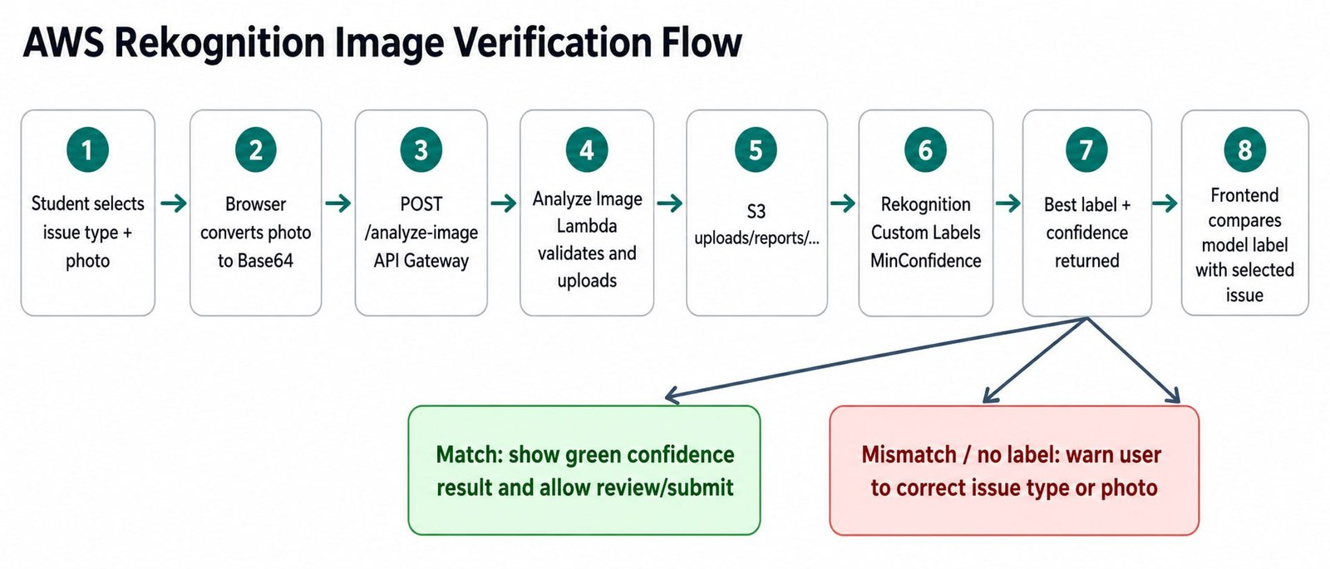
Rekognition Image Verification Flow
How an uploaded photo becomes a confidence score in the browser
99.91%
live Staircase Issue match returned by the deployed model — no hardcoded result
Input
Validate & store
Detect
Return
Browser sends Base64 to POST /analyze-image with the token.
Type and 5 MB checks, then written to uploads/reports/.
DetectCustomLabels runs on the S3 object with the model ARN.
Best label, confidence and imageKey return to the front end.
9
Notes:
This is the runtime path, and it matters for the deep-understanding mark.
The browser never calls Rekognition. It sends the image as Base64 to my analyze-image route with the Authorization header. The Lambda validates the content type, rejects anything over five megabytes and rejects invalid Base64, then writes the object into uploads/reports with a year, month and UUID key.
Only then does it call DetectCustomLabels against that S3 object, using the project version ARN and confidence floor from environment variables. It sorts the returned labels by confidence and sends back only the best one, along with the image key so the same photo is never re-uploaded.
Three tuning decisions worth naming: MIN_CONFIDENCE is configurable with a default of 60, the image key is reused instead of resending the payload, and the Other category uploads the photo but skips inference — I would rather have manual review than force a wrong prediction.
[5:00-5:45]

Slide 9
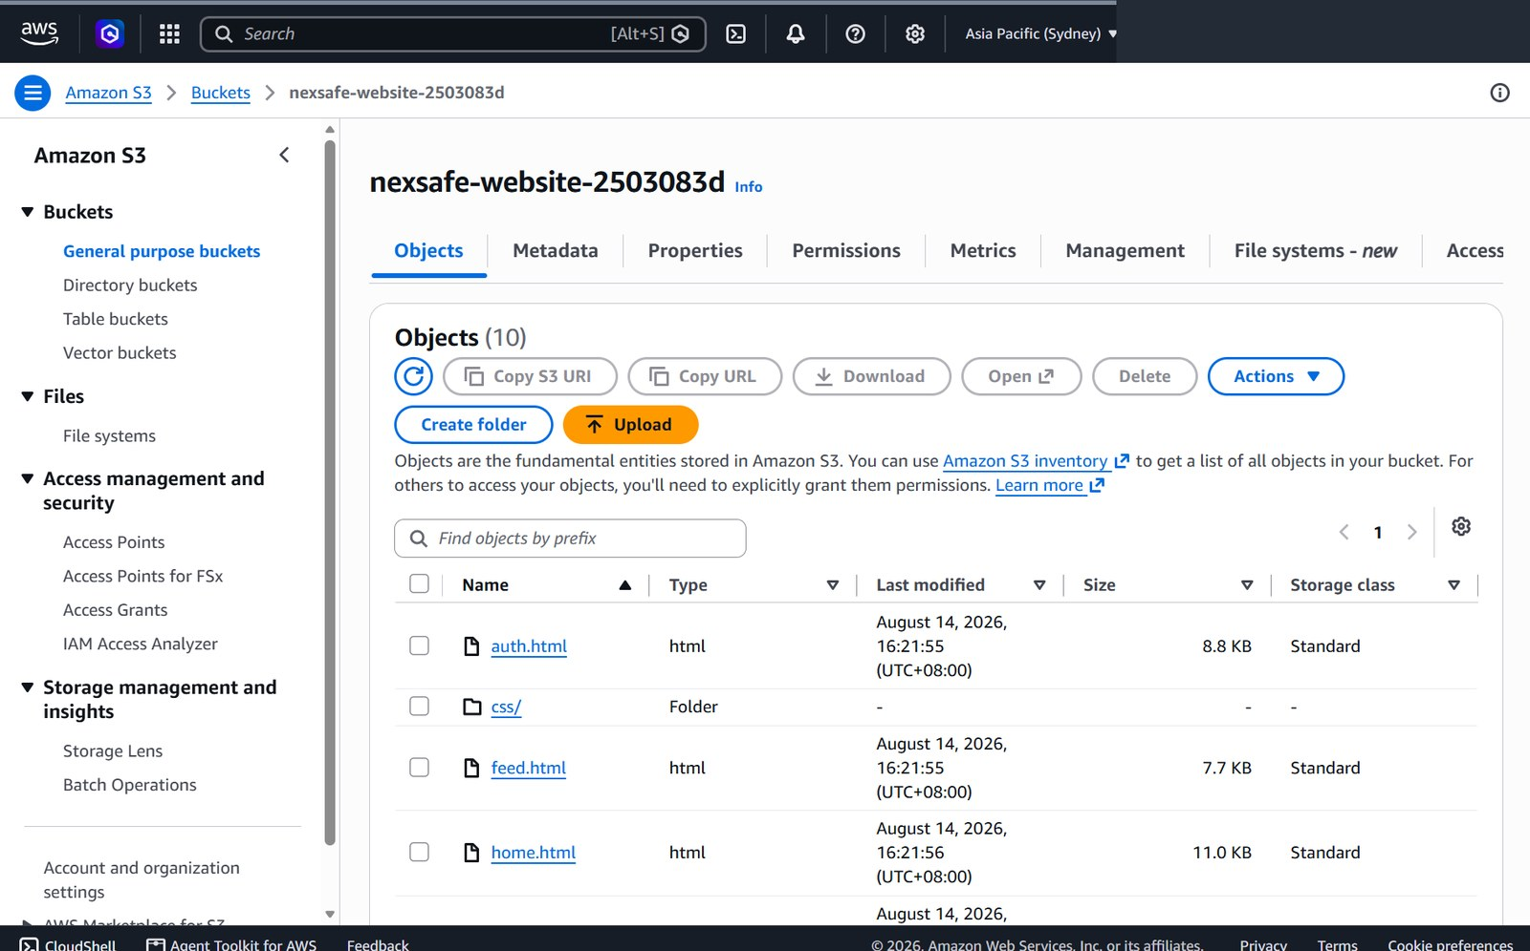
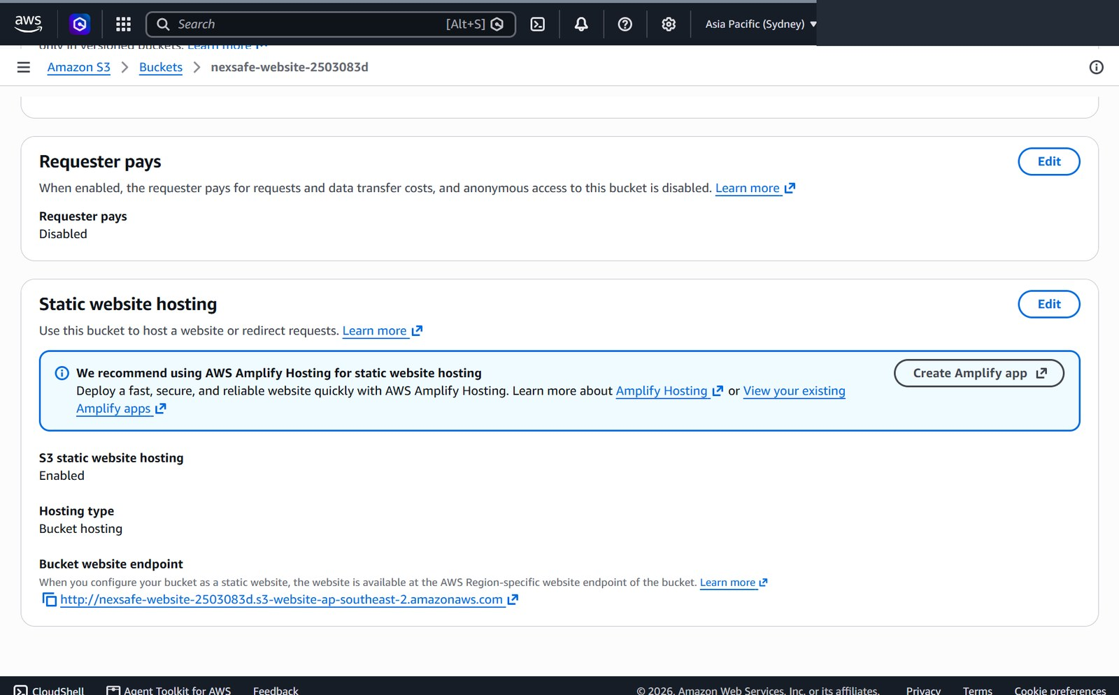
Deployment Steps 1 — Storage & Hosting
Steps 1 to 4: the front end goes up, and then it is locked down
Prepare the web application
1
Eight HTML pages plus css/ and js/; common.js points at the deployed API base URL and sends the ID token.
Create the website bucket
2
nexsafe-website-2503083d in ap-southeast-2, static website hosting enabled, object list verified.
Website files deployed to the S3 website bucket
Secure the website bucket
3
Block all public access stays on; s3:GetObject is granted only to CloudFront with a matching AWS:SourceArn.
Create the AI / data bucket
4
dataset/train, dataset/test and uploads/reports prefixes; CloudFront read scoped to uploads/reports/*.
S3 static website hosting enabled
10
Notes:
The deployment is eleven steps, ordered so that nothing depends on something that does not exist yet.
Step one is confirming the application itself — eight pages plus the CSS and JS folders, with common.js pointing at the API base URL.
Step two creates the website bucket in ap-southeast-2 and enables static website hosting, which is the serverless hosting requirement for this project.
Step three is the one I want to highlight. I did not use a public-read bucket policy. Block all public access stays on, and the policy grants GetObject to the CloudFront service principal only when the SourceArn matches my distribution.
Step four creates a separate data bucket for the model datasets and uploaded evidence, with the same treatment.
[5:45-6:25]

Slide 10
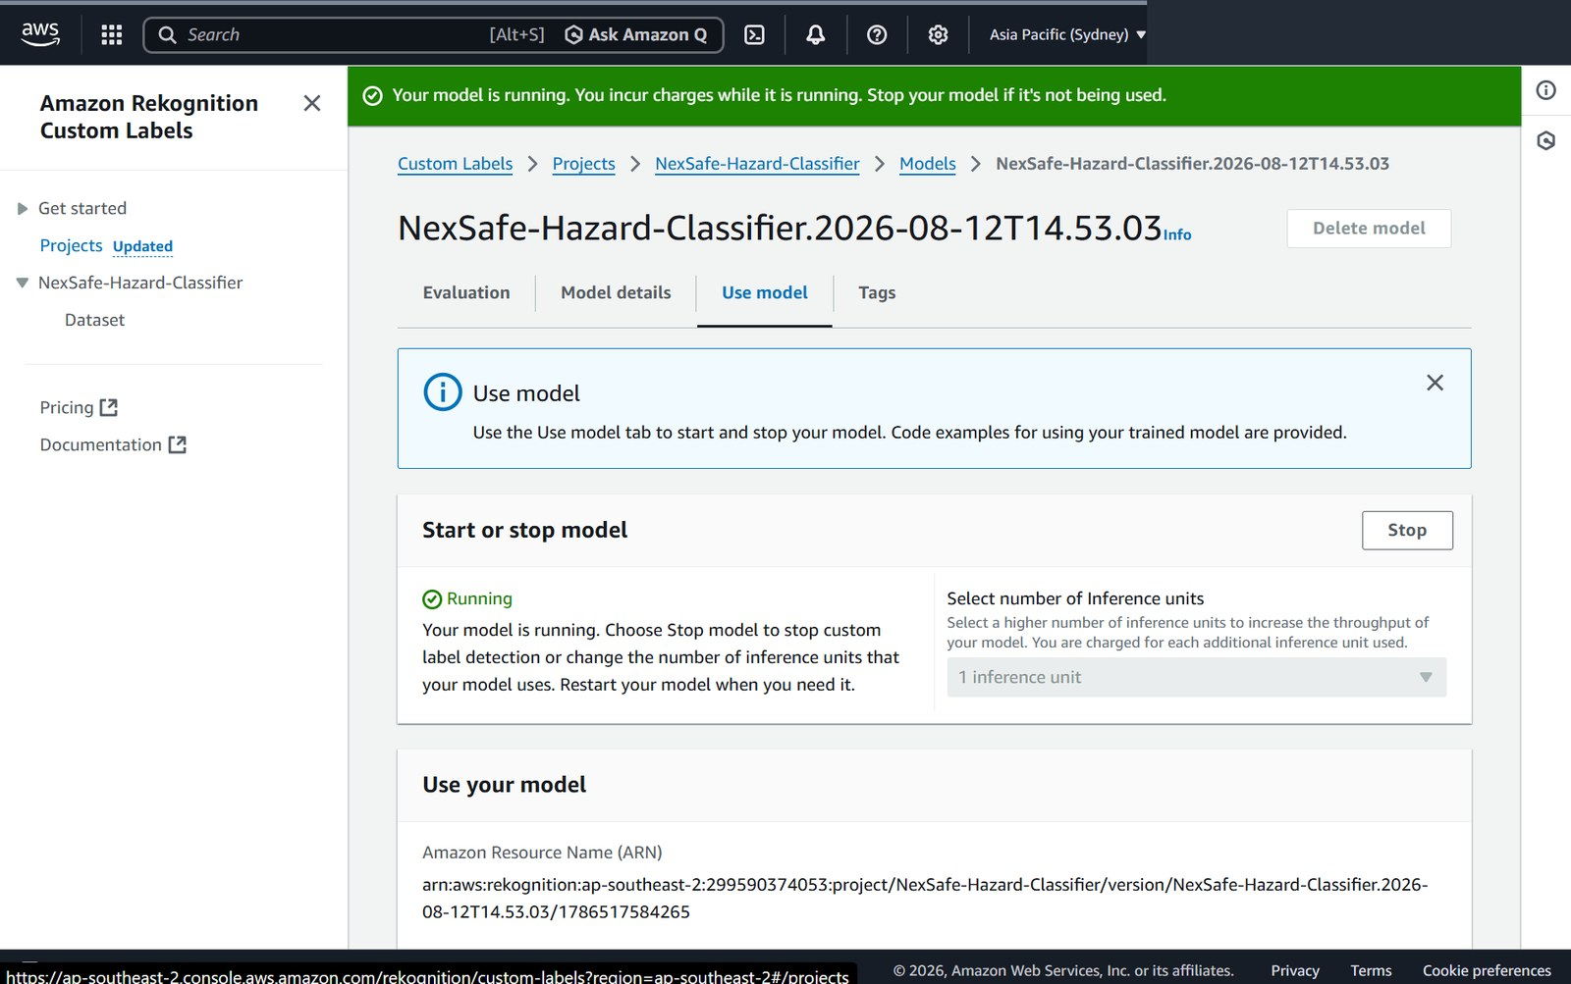
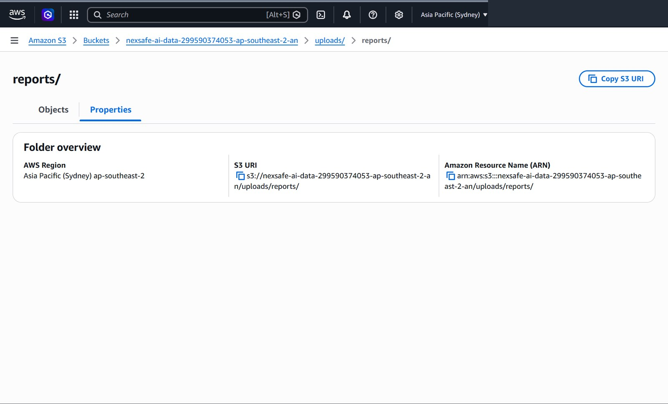
Deployment Steps 2 — AI Model & Backend
Steps 5 to 7: train and start the model, then wire up the two Lambdas and the database
Train and start Custom Labels
5
Associate the labelled data, train a project version, review the metrics, then start the version with one inference unit and record its ProjectVersionArn.
Configure the Analyze Image Lambda
6
UPLOAD_BUCKET, REKOGNITION_MODEL_ARN, MIN_CONFIDENCE and PUBLIC_IMAGE_BASE_URL set as environment variables — never in browser code.
Model RUNNING with one inference unit and its ARN
Create RDS MySQL and the Reports Lambda
7
Node.js function bundles mysql2/promise; DB_HOST, DB_PORT, DB_NAME, DB_USER and DB_PASSWORD are environment variables; the reports table is created if missing.
Runtime report-image prefix in the data bucket
11
Notes:
Step five is training and, importantly, starting the model. A Custom Labels project version has to be in the RUNNING state before DetectCustomLabels will succeed — a trained but stopped model returns an error, which cost me time early on. I run one inference unit, which suits a prototype workload.
Step six configures the analyze-image Lambda. Every environment-specific value is an environment variable: the bucket, the model ARN, the confidence floor and the public image base URL. That means I can retrain and repoint the model without touching a line of front-end code.
Step seven creates the MySQL database and the reports Lambda. The function imports mysql2/promise, so that dependency has to be in the deployment package, and the database credentials are environment variables — they are not in the source, not in the browser and not in this report.
[6:25-7:00]

Slide 11
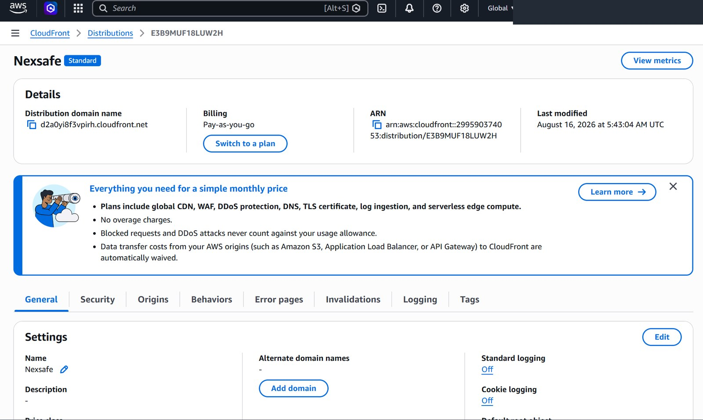
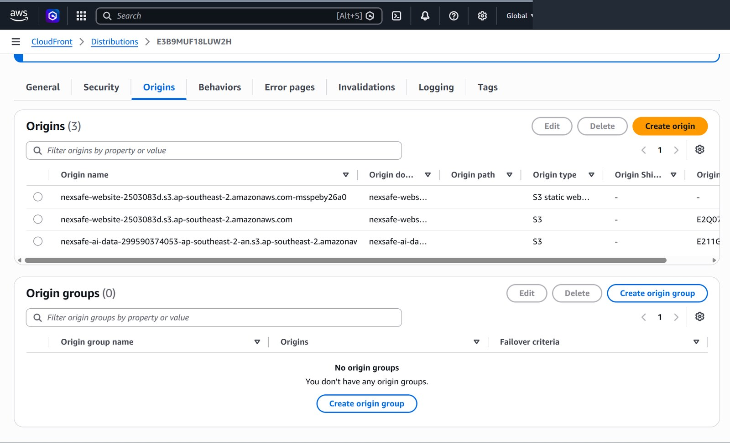
Deployment Steps 3 — API, Identity & Delivery
Steps 8 to 11: expose the backend safely, then put CloudFront in front of everything
Create the API Gateway HTTP API
8
Seven routes on the dev stage with Lambda integrations, browser CORS, and a Cognito JWT authorizer supplying validated claims.
Configure Cognito, SNS and Location
9
students and staff groups with test users; staff and student notification topics; ap-southeast-2 map style with a restricted browser key.
Enabled distribution and final HTTPS domain
Create the CloudFront distribution
10
Enabled distribution d2a0yi8f3vpirh.cloudfront.net with the website and data S3 origins and index.html as the root object.
End-to-end verification
11
Student create → AI label → feed and My Reports → staff update → notification → cache invalidation after any file change.
CloudFront origins: website bucket and data bucket
12
Notes:
Step eight creates the HTTP API with the seven routes, CORS for the browser origin, and the Cognito JWT authorizer, so the token is validated at the gateway before Lambda even starts.
Step nine sets up the supporting services: the two Cognito groups with test users in each, the SNS topics, and the Amazon Location map style with a key restricted to map use.
Step ten puts CloudFront in front. Both S3 buckets stay private, CloudFront is the only reader, and the CloudFront domain is the final URL I submitted.
Step eleven is the full rehearsal I run before any demo: create a report as a student, confirm the AI label, check the feed, switch to staff, update it, confirm the notification, and invalidate the cache if I changed any file. That last part matters — an old cached JavaScript file will make a working deployment look broken.
[7:00-7:35]

Slide 12
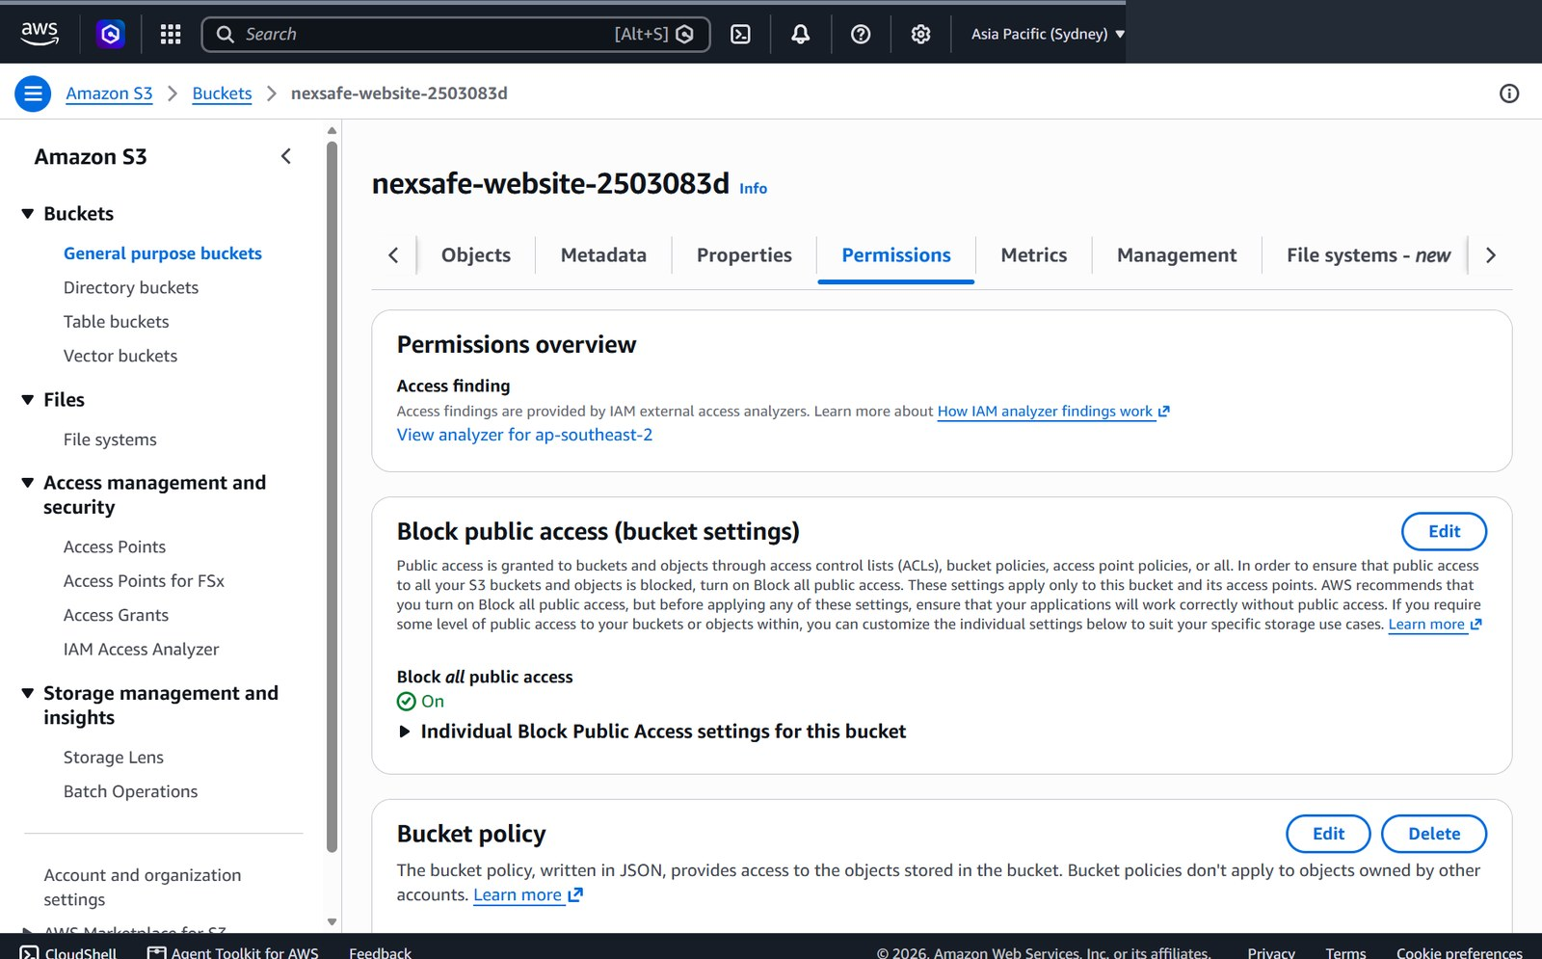
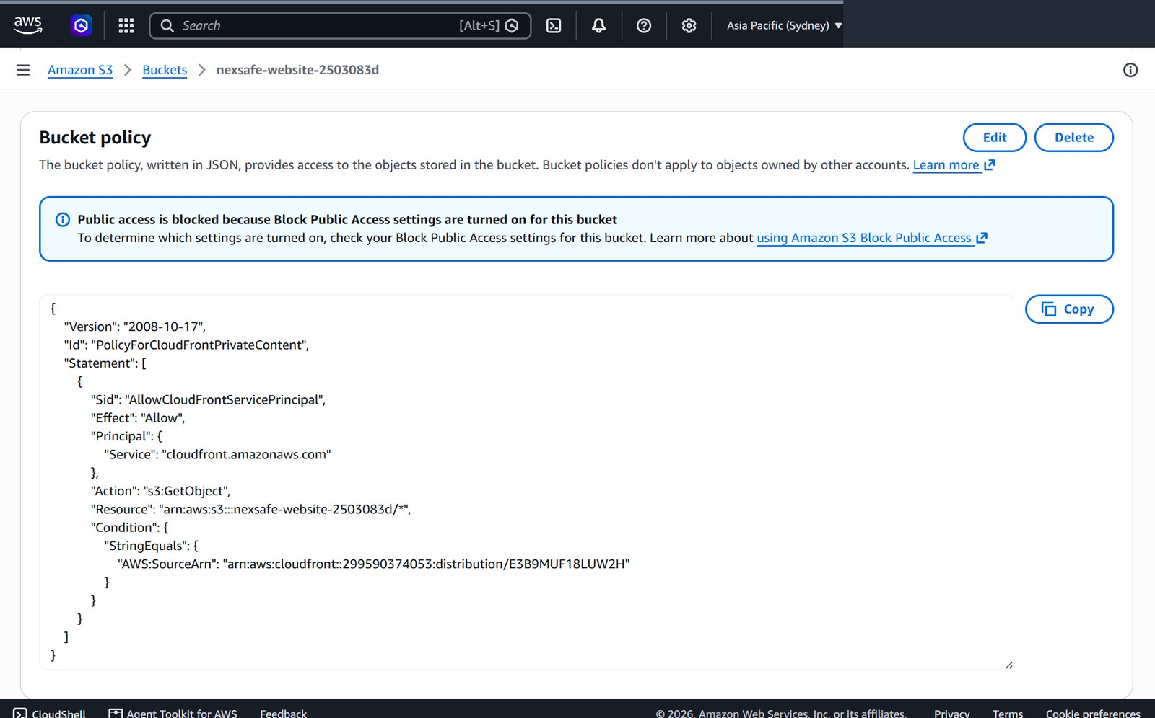
Cloud Security & Least Privilege
Five independent layers — no single control is the whole defence
Private buckets
CloudFront-scoped policies
Block all public access is on for both the website and data buckets. There is no anonymous public-read policy anywhere in the deployment.
s3:GetObject is granted only to cloudfront.amazonaws.com with a matching SourceArn, and the data bucket is limited to uploads/reports/*.
Block all public access enabled on the bucket
JWT checked at the gateway
Re-checked in the backend
API Gateway validates the Cognito ID token before any Lambda code executes; the front end sends Authorization: Bearer.
Lambda re-reads cognito:groups. PUT and DELETE fail for a non-staff account even if the request bypasses the interface entirely.
Bucket policy restricted to the distribution SourceArn
Defence in depth bucket policy → identity → JWT → group check → IAM. Secrets stay in Lambda environment variables.
14
Notes:
Security was graded on data protection, access rights and authentication, so I treated it as five separate layers rather than one control.
Both buckets are fully private. The only principal allowed to read them is my CloudFront distribution, matched by SourceArn, and on the data bucket that permission is narrowed further to the uploads/reports prefix — nothing can read my training data through CloudFront.
Identity is Cognito. The token is validated at the gateway, and then validated again for privilege inside the Lambda. The reason I check twice is that hiding a button is not a security control.
Finally, no secrets travel to the browser. The database password, the model ARN and the SNS topic ARNs are Lambda environment variables, and parameterised queries are used for ID-based operations.
[8:10-8:45]

Slide 13
Challenges Faced During Development
Four problems that changed the design, and what each one taught me
ISSUE 1
ISSUE 2
Report images returned AccessDenied
The model could return a wrong or empty label
Fix Served images through CloudFront and scoped the data-bucket policy to uploads/reports/*.
Fix Trained Custom Labels, reviewed per-label metrics, kept MIN_CONFIDENCE configurable and routed Other to manual review.
Why it matters Images stay private and still render in the site.
Why it matters Domain-relevant recognition, no hardcoded result.
ISSUE 3
ISSUE 4
401 and 403 errors, and role leakage
Lambda / RDS failures and stale cache
Fix Attached the Cognito JWT authorizer and re-checked cognito:groups inside the Lambda for PUT and DELETE.
Fix Bundled mysql2/promise, moved DB_* to environment variables, matched routeKey to routes and invalidated CloudFront.
Why it matters Security no longer depends on hidden navigation.
Why it matters Stable CRUD, and the demo runs the newest code.
15
Notes:
Four problems genuinely changed the design.
First, private images. Once I blocked public access, the report photos stopped loading. Rather than making the bucket public, I routed image display through CloudFront and scoped the policy to the uploads prefix.
Second, AI reliability. Generic detection gave unusable answers, so I trained Custom Labels, checked per-label metrics, made the confidence floor configurable, and sent the Other category to manual review instead of forcing a prediction.
Third, authorisation. I was getting 401s and 403s while wiring up the authorizer, and fixing that properly meant checking the group claim in the backend as well.
Fourth, deployment reliability. The mysql2 dependency, environment variables and routeKey matching fixed the Lambda side, and CloudFront invalidation fixed the case where I had updated a file but the old one was still being served.
[8:45-9:20]

Slide 14
Potential Enhancements & Demonstration
Where NexSafe goes next — and the running order for the live demo
Expand the AI model
Analytics dashboard
Add images to the weaker classes, introduce new issue types and compare metrics after each retrain.
Charts for issue type, building, average resolution time and staff workload from the stored RDS data.
Demonstration video (unlisted)
[https://youtu.be/iN1GmdFdWw8]
Assignment & escalation
Production hardening
Route reports to a maintenance team with deadlines and escalation for unresolved high-priority hazards.
Custom domain, WAF rules, CloudWatch alarms, tighter key restrictions and tested backup and restore.
Priority: dataset first, then analytics, then production monitoring.
16
Notes:
Four enhancements, in the order I would actually do them. The dataset comes first because the per-label metrics already tell me which classes are weakest. Analytics is next, because the RDS data to build it is already being collected. Then assignment and escalation, then production hardening.
The unlisted YouTube recording is the backup if a service is unavailable. Otherwise I will now run the live demonstration in the order shown here.
REMINDER: paste the unlisted YouTube link into this slide before submitting.
[9:20-9:45]

Slide 15
Thank you
Questions and live demonstration
Live site https://d2a0yi8f3vpirh.cloudfront.net/
Notes:
That is the walkthrough. I'll take questions, and I'm ready to run the live demonstration on the CloudFront URL now.
[9:45-10:00]

